Slide 1

Marginal Models

Slide 2

Why do I need to use a different kind of statistics?
What’s wrong with using correlation, ANOVA, t-tests, logistic regression?

Slide 3
Why do I need to use a different kind of statistics?
What’s wrong with using correlation, ANOVA, t-tests, logistic regression?
Those are fine if each person is measured only once.

Slide 4
Why do I need to use a different kind of statistics?
What’s wrong with using correlation, ANOVA, t-tests, logistic regression?
Those are fine if each person is measured only once.
  Example: Do Southerners lose their accent when they live abroad?
    Correlation is just fine

Slide 5
Why do I need to use a different kind of statistics?
What’s wrong with using correlation, ANOVA, t-tests, logistic regression?
Those are fine if each person is measured only once.
  Example: Do surfers front the /u/ in dude more than non-surfers?
    T-test is just fine

Slide 6
Why do I need to use a different kind of statistics?
What’s wrong with using correlation, ANOVA, t-tests, logistic regression?
They assume one measurement per person
If there are repeated measures, they may produce invalid results
  You want valid results, right?

Slide 7
Why do I need to use a different kind of statistics?
What’s wrong with using correlation, ANOVA, t-tests, logistic regression?
  Stats that handle repeated measures
    Paired t-test
    Repeated measures ANOVA

Slide 8
Why do I need to use a different kind of statistics?
What’s wrong with using correlation, ANOVA, t-tests, logistic regression?
  Stats that handle repeated measures
    Paired t-test
    Repeated measures ANOVA
  Mixed effects and marginal models handle paired t-test, and repeated measures ANOVA, and regression models, and missing data.

Slide 9
Why do I need to use a different kind of statistics?
What’s wrong with using correlation, ANOVA, t-tests, logistic regression?
Linguistic data often gets multiple measurement from a single person
  Example: Sociolinguistic interview to measure –ing > -in’
    Each case of –ing or –in’ is viewed in its social and linguistic context
Participant | Variant | Gender | Phone after | Addressee
Jeff | -ing | M | [b] | Jill
Jeff | -in’ | M | Pause | Jill
Jeff | -in’ | M | [i] | Jill
Jeff | -ing | M | [l] | Bob
Sally | -in’ | F | Pause | Carl
Sally | -in’ | F | [r] | Ross
Sally | -in’ | F | [ej] | Ross

Slide 10
Why do I need to use a different kind of statistics?
But wait! This is just how it’s done in sociolinguistics!

Slide 11
Why do I need to use a different kind of statistics?
But wait! This is just how it’s done in sociolinguistics!
  True, but it has been wrong
  Many warning voices have been raised recently:
    Daniel Ezra Johnson, Harald Baayen, etc.
  Computers couldn’t handle mixed effects and marginal models until recently

Slide 12
Why do I need to use a different kind of statistics?
What’s wrong with using correlation, ANOVA, t-tests, logistic regression?
What if analysis shows men use more –in’ forms, but you don’t pay attention to repeated measures?
Participant | Gender | % -in’
1 | M | 53
2 | M | 22
3 | M | 34
4 | M | 30
5 | F | 29
6 | F | 31
7 | F | 33

Slide 13
Why do I need to use a different kind of statistics?
What’s wrong with using correlation, ANOVA, t-tests, logistic regression?
What if analysis shows men use more –in’ forms, but you don’t pay attention to repeated measures?
Maybe its not men in general, but participant 1 skews the results
Mixed effects controls for this kind of thing
Participant | Gender | % -in’
1 | M | 53
2 | M | 22
3 | M | 34
4 | M | 30
5 | F | 29
6 | F | 31
7 | F | 33

Slide 14
Why do I need to use a different kind of statistics?
What’s wrong with using correlation, ANOVA, t-tests, logistic regression?
Linguistic data often gets multiple measurement from a single person
  Example: Psycholinguistic study where participants give reaction times to several different verbs, nouns, and adjectives.
    Gender is an independent variable

Slide 15
Why do I need to use a different kind of statistics?
What’s wrong with using correlation, ANOVA, t-tests, logistic regression?
Linguistic data often gets multiple measurement from a single person
  Example: Psycholinguistic study where participants give reaction times to several different verbs, nouns, and adjectives.
    Gender is an independent variable
    One participant had two lattes before test and was really fast
    If he only gave one response he won’t affect mean male response time much

Slide 16
Why do I need to use a different kind of statistics?
What’s wrong with using correlation, ANOVA, t-tests, logistic regression?
Linguistic data often gets multiple measurement from a single person
  Example: Psycholinguistic study where participants give reaction times to several different verbs, nouns, and adjectives.
    Gender is an independent variable
    One participant had two lattes before test and was really fast
    If he only gave one response he won’t affect mean male response time much
    If he gives many responses he’ll skew the mean for males and make the results inaccurate.
    Mixed-effect and marginal models control for this kind of problem

Slide 17
Repeated Measures Introduce Correlated Residuals
ANOVA, correlation, etc. give inaccurate results when there are correlated residuals
  What the freak are residuals anyway?

Slide 18
Repeated Measures Introduce Correlated Residuals
ANOVA, correlation, etc. give inaccurate results when there are correlated residuals
  What the freak are residuals anyway?
  Weight of different volumes of water
  Residual is the distance from a data point to the regression line

Slide 19
Repeated Measures Introduce Correlated Residuals
Frequency of end up Verbing expressions by decade
  E.g. ended up going, ends up working, ending up in China, etc
  Repeated measures taken from four corpora
  Residuals are distances from data point to regression line (blue lines)

Slide 20
Repeated Measures Introduce Correlated Residuals
Correlated residuals
  All COHA residuals are positive (above line). They are highly correlated
  All GoogleUS are negative (below line). They are highly correlated

Slide 21
Repeated Measures Introduce Correlated Residuals
Correlated residuals
  The reaction times the latte hyped guy gave in the experiment would be like the GoogleUK data points (if you switch decade for experimental word and frequency for reaction time)

Slide 22
How do you Eliminate Correlations Caused by Repeated Measures?
In a mixed-effects model add a random intercept
  Make an individual intercept for every unit that has repeated measures
  The residuals are now calculated to the units personal line, not the overall line

Slide 23
How do you Eliminate Correlations Caused by Repeated Measures?
  Individual intercepts are the mean amount the corpus deviates from the overall regression line.
  The individual intercept is parallel to the overall regression line
  It is called an intercept because it is measured at the point the line crosses (intercepts) the vertical axis at zero.

Slide 24
How do you Eliminate Correlations Caused by Repeated Measures?
  Look at circles representing GoogleUS. When there is no random intercept, all residuals are negative. They are correlated
  When there is a random intercept, some are above the line and others are below. There is no longer a correlation. (Generally, not always)

Slide 25
How do you Eliminate Correlations Caused by Repeated Measures?
  Look at circles representing GoogleUS. When there is no random intercept, all residuals are negative. They are correlated
  When there is a random intercept, some are above the line and others are below. There is no longer a correlation. (Generally, not always)
  The residuals are smaller, so the model fits the data better.

Slide 26
Repeated measures in corpus study
Random effects modify the residuals by modifying the intercept or slope (mixed-effects)

Slide 27
Repeated measures in corpus study
Random effects modify the residuals by modifying the intercept or slope (mixed-effects)
Repeated effects don't change the residuals, they just estimate them (marginal model)

Slide 28
Mixed effects versus marginal models
When do you use each?
Try a mixed effects model first.

Slide 29
Mixed effects versus marginal models
When do you use each?
Try a mixed effects model first.
If your mixed effects model tells you:
  Hessian matrix not positive definite
  Model failed to converge
It is too computationally complex for a mixed-effects model
Use a marginal model instead

Slide 30
Repeated effects in a marginal model
Two estimates are made of the residuals
First: How spread out they are from the regression line at each point of measurement (variance)
  Point of measurement: Point in time, experimental condition
  How close or far from the line are the residuals?

Slide 31
Repeated effects in a marginal model
Two estimates are made of the residuals
First: How spread out they are from the regression line at each point of measurement (variance)
  Point of measurement: Point in time, experimental condition
  How close or far from the line are the residuals?
Second: How do the residuals change at each point of measurement? (covariance)
  They get larger over time
This information is put in the R matrix

Slide 32
Covariance structures
There are different estimates of the variance and covariance of the residuals

Slide 33
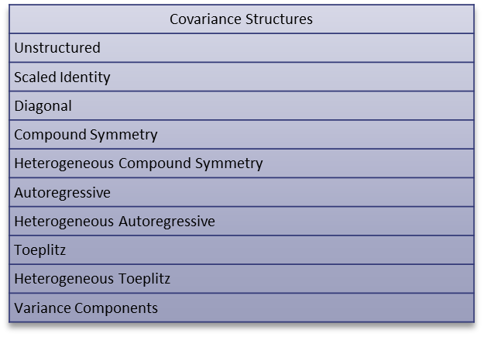
Covariance structures
There are different estimates of the variance and covariance of the residuals
They have funky names

Slide 34
Covariance structures
There are different estimates of the variance and covariance of the residuals
They have funky names
Do not use them in public or you may not get any dates

Slide 35
Covariance structures
What do they mean?

Slide 36
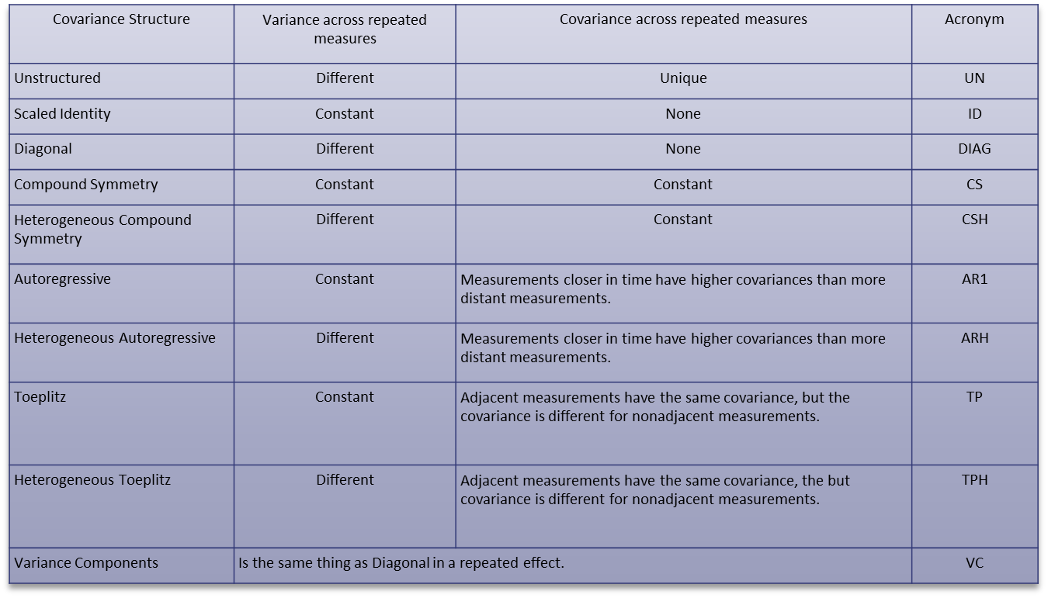
Covariance structures
What do they mean? They are different kinds of patterns

Slide 37
Covariance structures
What do you do with them?

Slide 38
Covariance structures
What do you do with them?
Find the one that fits your residuals the best

Slide 39
Covariance structures
What do you do with them? How do you do that?
Find the one that fits your residuals the best
Compare the -2RLLs with a likelihood test

Slide 40
Covariance structures
What do you do with them? How do you do that?
Find the one that fits your residuals the best
SPSS gives you a table like this for every model you run
Compare the -2RLLs with a likelihood test
Information Criteriaª
-2 Restricted Log Likelihood | -24.806
Akaike's Information Criterion (AIC) | -20.806
Hurvich and Tsai's Criterion (AICC) | -20.362
Bozdogan's Criterion (CAIC) | -16.004
Schwarz's Bayesian Criterion (BIC) | -18.004
The information criteria are displayed in smaller-is-better forms.
a. Dependent Variable: CubeRootFreq.

Slide 41
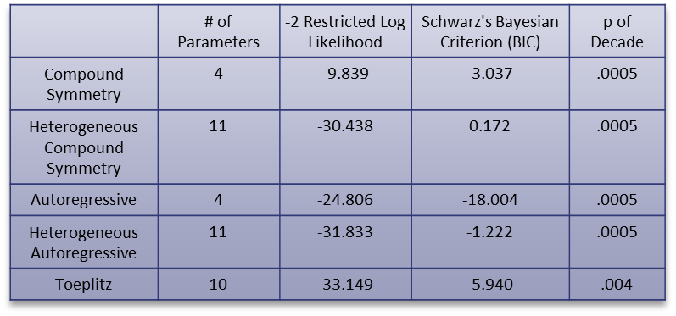
Covariance structures
What do you do with them? How do you do that?
Find the one that fits your residuals the best
SPSS gives you a table like this for every model you run
Compare the -2RLLs with a likelihood test
Compare the results with different covariance structures
Lowest -2RLL with fewest parameters wins!
Information Criteriaª
-2 Restricted Log Likelihood | -24.806
Akaike's Information Criterion (AIC) | -20.806
Hurvich and Tsai's Criterion (AICC) | -20.362
Bozdogan's Criterion (CAIC) | -16.004
Schwarz's Bayesian Criterion (BIC) | -18.004
The information criteria are displayed in smaller-is-better forms.
a. Dependent Variable: CubeRootFreq.

Slide 42
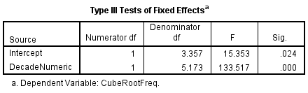
Covariance structures
Now that repeated measures are accounted for, report the results of the fixed effects
Example: “The effect of time (by decade) on the frequency of end up verbing expressions was significant (F (1, 5.173) = 133.517, p < .0005). The fact that repeated measures were taken from the four corpora was accounted for by running a marginal model with a heterogenous autoregressive covariance structure.”

Slide 43
Running a marginal model in SPSS
Using a repeated effect
Open the file endupVERBING.sav

Slide 44
Running a marginal model in SPSS
Using a repeated effect
Put the variable with repeated measures in the subjects box.

Slide 45
Running a marginal model in SPSS
Using a repeated effect
Put the variable with repeated measures in the subjects box.
Specify what the different points of measurement were taken from

Slide 46
Running a marginal model in SPSS
Using a repeated effect
Put the variable with repeated measures in the subjects box.
Specify what the different points of measurement were taken from
Choose the covariance structure

Slide 47
Running a marginal model in SPSS
Using a repeated effect
Specify the dependent variable

Slide 48
Running a marginal model in SPSS
Using a repeated effect
Specify the dependent variable
Put categorical independent variables in the factors box
Put continuous independent variables in the covariates box
Both the independent variables and the repeated effects variables are chosen here

Slide 49
Running a marginal model in SPSS
Using a repeated effect
Click on Fixed

Slide 50
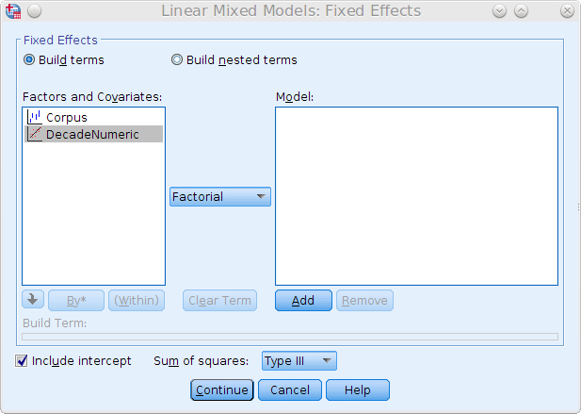
Running a marginal model in SPSS
Using a repeated effect
After clicking on Fixed, click on DecadeNumeric (or DecadeNUM)
Move it to the Model box by clicking on the Add button > Continue
From the variables chosen before (Decade and Corpus), this specifies Decade as the independent variable

Slide 51
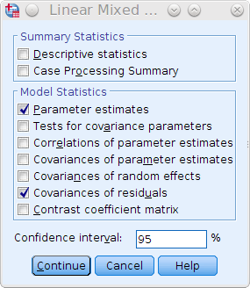
Running a marginal model in SPSS
Using a repeated effect
Click on Statistics
Choose Parameter estimates and Covariances of residuals > Continue > OK

Slide 52
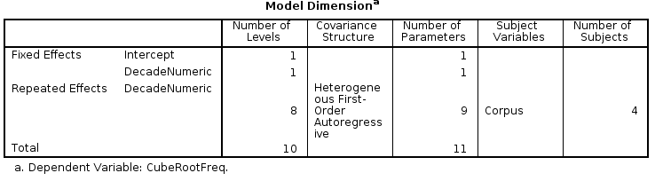
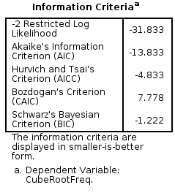
Running a marginal model in SPSS
Using a repeated effect
Go to output window
Note number of parameters and -2 Restricted Log Likelihood

Slide 53
Running a marginal model in SPSS
Using a repeated effect
Lets compare the heterogenous autoregressive covariance structure we just ran with a non-heterogenous autoregressive covariance structure

Slide 54
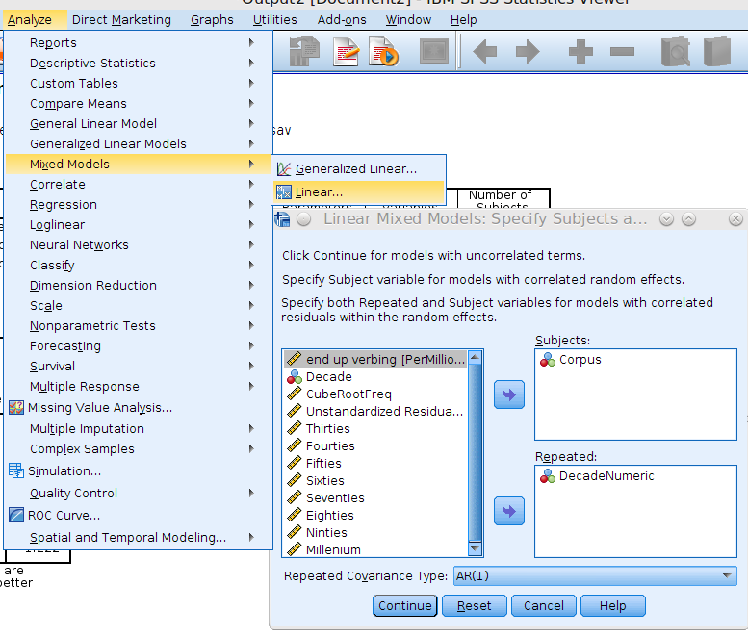
Running a marginal model in SPSS
Using a repeated effect
Lets compare the Autoregressive covariance structure we just ran with a heterogenous autoregressive covariance structure
Chose AR(1) in Repeated Covariance Type box > Continue > OK

Slide 55
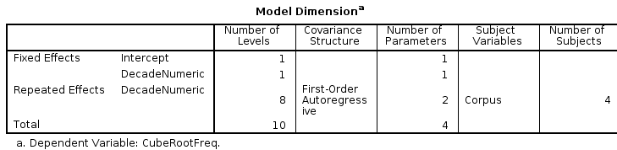
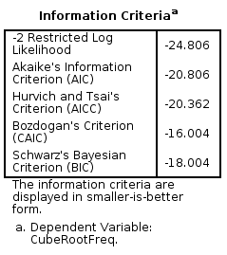
Running a marginal model in SPSS
Using a repeated effect
Go to results window
Note the number of parameters and -2LL for this model

Slide 56
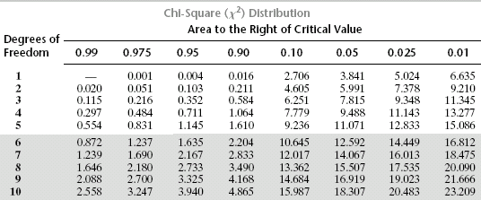
Running a marginal model in SPSS
Using a repeated effect
Let's compare using -2LL
At difference of 7 parameters, difference in -2LL needs to be 14.067 or greater for there to be a significant difference between models
We go with simpler model (with fewer parameters) even though the -2LL is not the smallest
Model | # parameters | -2LL
Hetero AR1 | 11 | -24.806
AR1 | 4 | -31.833
difference | 7 | 7.027

Slide 57
Running a marginal model in SPSS
Using a repeated effect
The best fit is heterogenous autoregressive covariance structure. Why?
Model | # parameters | -2LL
Hetero AR1 | 11 | -24.806
AR1 | 4 | -31.833
difference | 7 | 7.027

Slide 58
Running a marginal model in SPSS
Using a repeated effect
The best fit is heterogenous autoregressive covariance structure. Why?
Variance (of residuals) isn’t constant across time.

Slide 59
Running a marginal model in SPSS
Using a repeated effect
The best fit is heterogenous autoregressive covariance structure. Why?
Variance (of residuals) isn’t constant across time.
Covariance goes up with time.
(More variance in recent decades.)

Slide 60
Running a marginal model in SPSS
Using a repeated effect
The best fit is heterogenous autoregressive covariance structure. Why?
Variance (of residuals) isn’t constant across time.
Covariance goes up with time.
(More variance in recent decades.)
This is what heterogenous autoregressive models.

Slide 61
Running a marginal model in SPSS
Using a repeated effect
Open the file Dabrowska2010.sav
Linguists and non-linguists judged sentences for grammatical correctness
  Scale of 1-5 (1 is bad 5 is good)

Slide 62
Running a marginal model in SPSS
Using a repeated effect
Open the file Dabrowska2010.sav
Linguists and non-linguists judged sentences for grammatical correctness
  Scale of 1-5 (1 is bad 5 is good).
Some sentences were grammatical and others ungrammatical.

Slide 63
Running a marginal model in SPSS
Using a repeated effect
Open the file Dabrowska2010.sav
Linguists and non-linguists judged sentences for grammatical correctness
  Scale of 1-5 (1 is bad 5 is good).
Some sentences were grammatical and others ungrammatical.
Dependent variable:
  Judgment (Score)
Independent variables:
  Linguist or not (Group)
  Grammatical or not (GramUngram)
  Interaction of Group and GramUngram

Slide 64
Running a marginal model in SPSS
Using a repeated effect
Open the file Dabrowska2010.sav
Linguists and non-linguists judged sentences for grammatical correctness
  Scale of 1-5 (1 is bad 5 is good).
Some sentences were grammatical and others ungrammatical.
Dependent variable:
  Judgment (Score)
Independent variables:
  Linguist or not (Group)
  Grammatical or not (GramUngram)
  Interaction of Group and GramUngram
Repeated effect: Participant by GramUngram with UN, CS, or CSH covariance structures

Slide 65
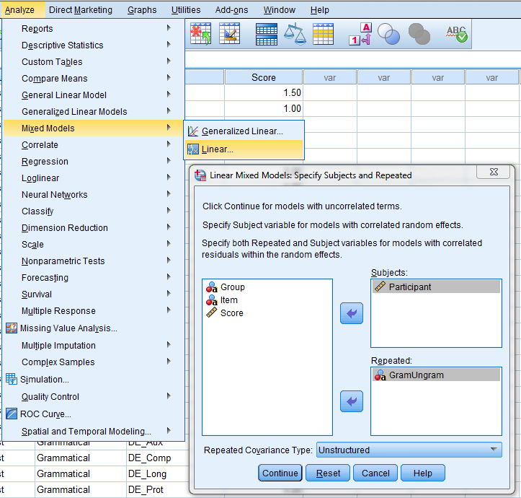
Running a marginal model in SPSS
Using a repeated effect

Slide 66
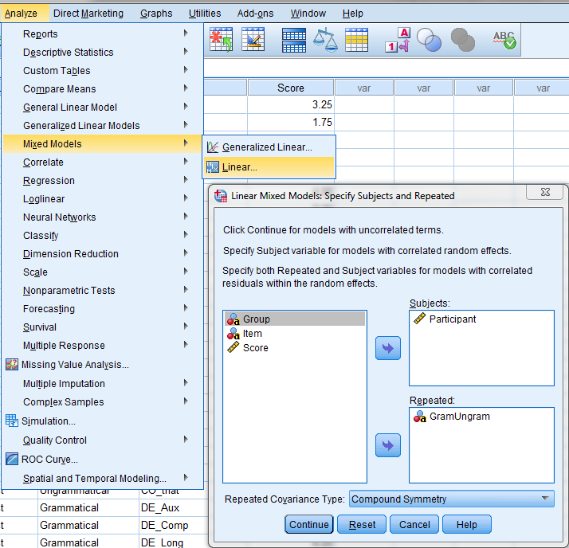
Running a marginal model in SPSS
Using a repeated effect
Repeated effect of Participant by GramUngram

Slide 67
Running a marginal model in SPSS
Using a repeated effect
Repeated effect of Participant by GramUngram
Compound Symmetry covariance structure
Press Contiue

Slide 68
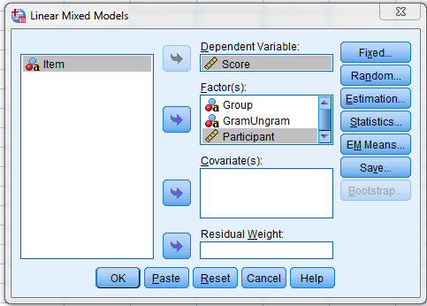
Running a marginal model in SPSS
Using a repeated effect
Specify the dependent variable
Put categorical independent variables in the factors box
Put continuous independent variables in the covariates box
Both the independent variables and the repeated effects variables are chosen here
Click OK

Slide 69
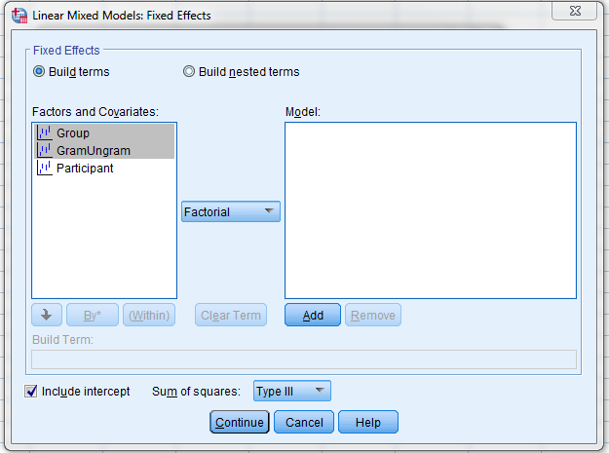
Running a marginal model in SPSS
Using a repeated effect
Chose Group, GramUngram as independent variables
Chose Factorial to make an interaction variable between the two
Click Add

Slide 70
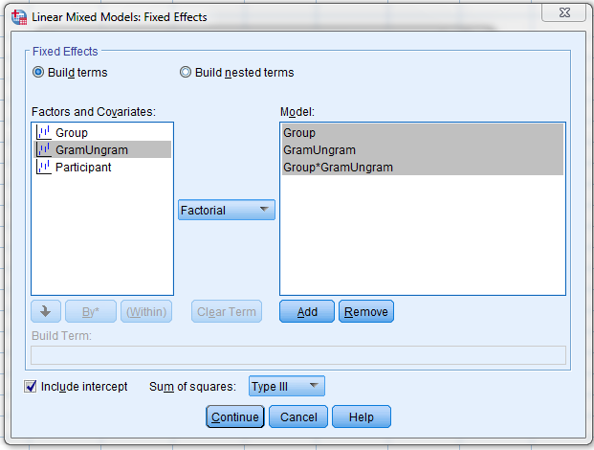
Running a marginal model in SPSS
Using a repeated effect
Click on Continue

Slide 71
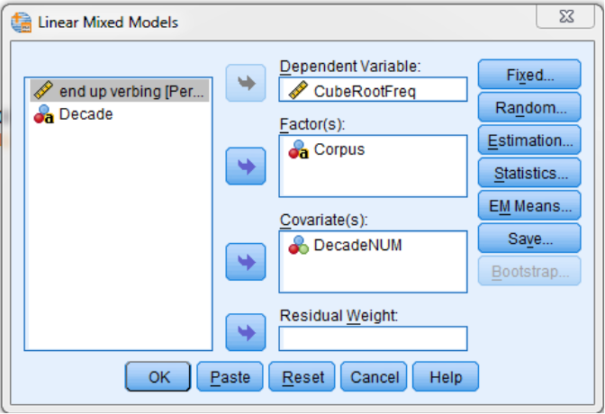
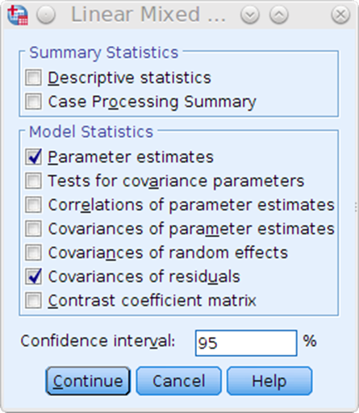
Running a marginal model in SPSS
Using a repeated effect
Click on Statistics
Choose Parameter estimates and Covariances of residuals > Continue > OK

Slide 72
Running a marginal model in SPSS
Using a repeated effect
You get this error.
Warnings
The levels of the repeated effect are not different for each observation within a repeated subject.
Execution of this command stops.

Slide 73
Running a marginal model in SPSS
Using a repeated effect
You get this error.
Participant by GramUngram is problem
There are more than one item in the Gram and Unbram groups
We need to specify this
Warnings
The levels of the repeated effect are not different for each observation within a repeated subject.
Execution of this command stops.

Slide 74
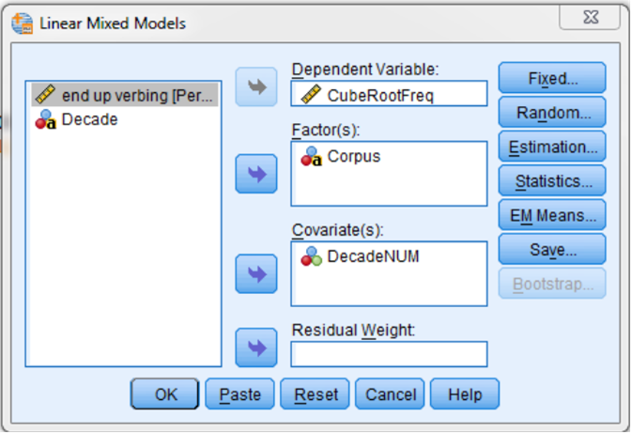
Running a marginal model in SPSS
Using a repeated effect
This change is done in the syntax editor.
Click Paste to access it.

Slide 75
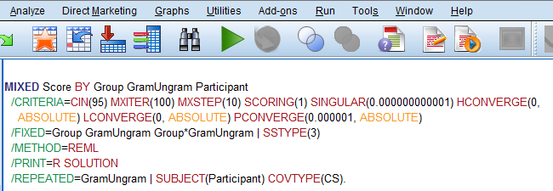
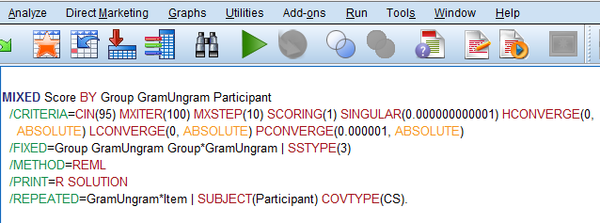
Running a marginal model in SPSS
Using a repeated effect
This is under the hood.
Change the last line to this:

Slide 76
Running a marginal model in SPSS
Using a repeated effect
Now place the curor in the text somewhere and press the green arrow.

